Slide 1
The Minoans and Mycenaeans
Who were they?
Where did they come from?
What did they accomplish?
Where did they go?

Slide 2
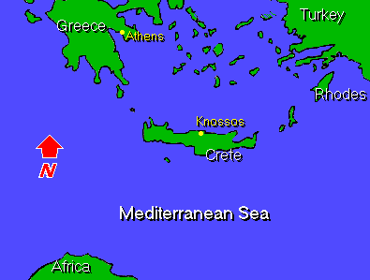
Minoan civilization arose on the island of Crete.

Slide 3
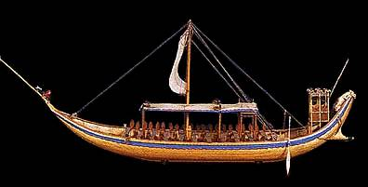
Legacy (or gift from the past)
Their legacy was as masters of the sea and great shipbuilders.

Slide 4
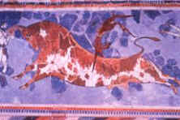
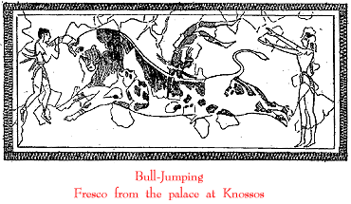
Bull Leaping
Bull leaping or bull fighting was both a sport and a religious ceremony. Don’t try this at home.

Slide 5
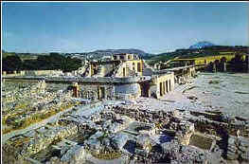
The Palace
One of the largest cities on Crete was Knossos. A great palace was located there - the Palace of Knossos where the legendary King Minos lived.

Slide 6
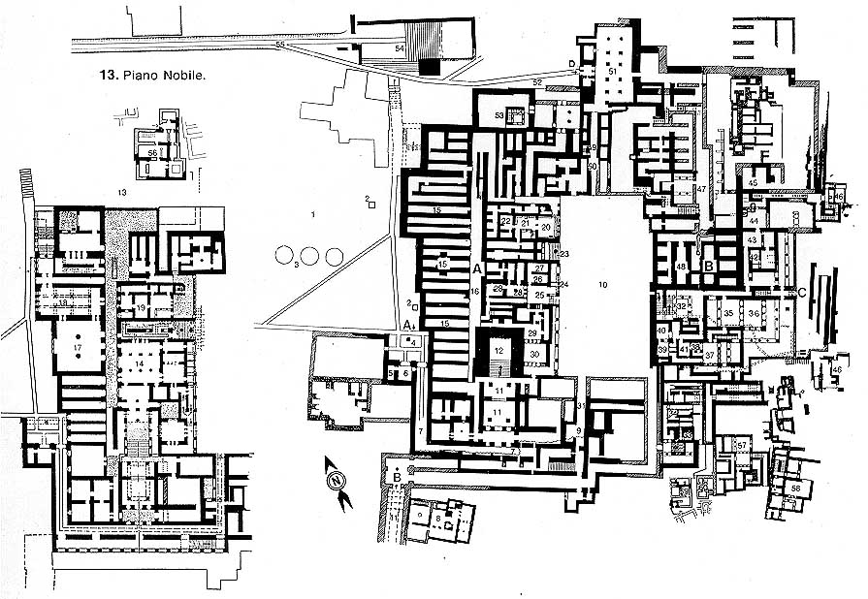
The palace had several passageways.

Slide 7
Labyrinth
The palace had a network of paths through which it was difficult to find one’s way.
Labyrinth means double ax so the palace was called the “House of the Double Ax.”
In this labyrinth, it is said, lived a Minotaur - a beast that was half man and half bull.
To construct a labyrinth, go to
www.puzzles.com/PuzzlePlayground/KnossosLabyrinth/KnossosLabyrinth.htm

Slide 8
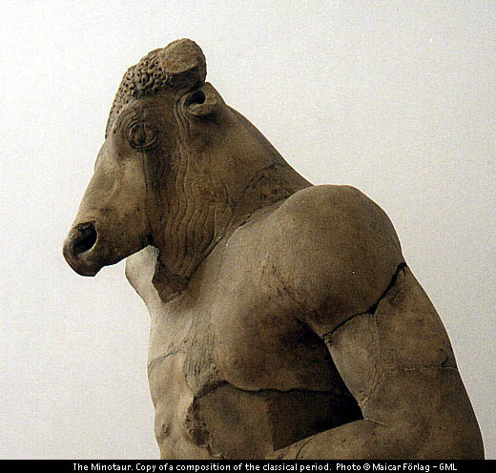

Slide 9
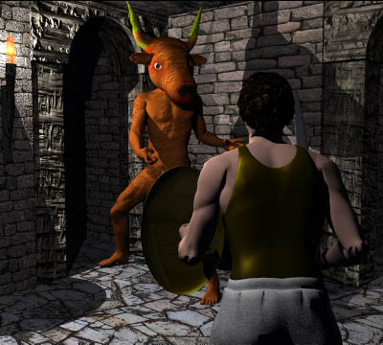
Every year for nine years, seven youths and maidens came as tribute from Athens. These young people were also locked in the labyrinth for the Minotaur to feast upon.
When the Greek hero Theseus reached Athens, he learned of the Minotaur and the sacrifices, and wanted to end this. He volunteered to go to Crete as one of the victims. Upon his arrival in Crete, he met Ariadne, Minos's daughter, who fell in love with him. She promised she would provide the means to escape from the maze if he agreed to marry her. When Theseus did, she gave him a simple ball of thread, which he was to fasten close to the entrance of the maze. He made his way through the maze, while unwinding the thread, and he stumbled upon the sleeping Minotaur. He beat it to death and led the others back to the entrance by following the thread.

Slide 10
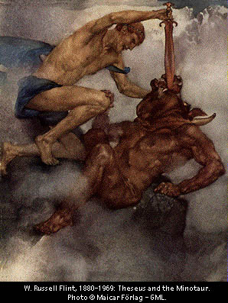

Slide 11
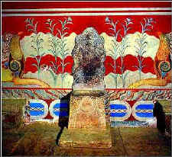
Why did they end?
No one is certain why Minoan civilization came to an end. But about 1400 B.C., control of the sea and Crete passed to the Mycenaeans.

Slide 12
Where did they come from?
The Mycenaeans came from the grasslands of southern Russia to the lowlands of Greece. They traded with and learned much from the Minoans.

Slide 13
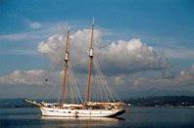
Trojan War/Homer’s Iliad
The Mycenaeans went to war with Troy because Troy was controlling a trade route and unfairly taxing ships going from southern Russia to Greece.

Slide 14
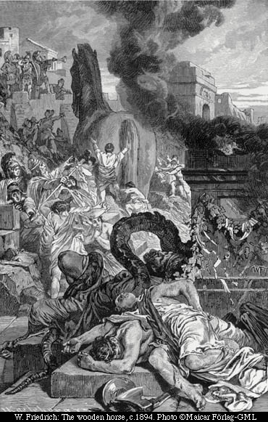
The Iliad
About 500 years later, a blind Greek poet, Homer, told the story of the Trojan war - but not quite exactly as it happened.

Slide 15
Homer’s version
The Trojan prince Paris fell in love with Helen, the wife of the Mycenaean king. He kidnapped her, taking her to Troy. The Mycenaeans followed to get her back.
After ten years of fighting, Odysseus suggested they build a large wooden horse and place their best soldiers in it. Then the rest of the Mycenaeans returned to their ships and sailed away.

Slide 16
When the Trojans saw the horse
and the soldiers leaving, they thought it was a gift and pulled it into the city. Once out of sight, Odysseus turned the ships around and began to sail back toward Troy. During the night, the soldiers inside the horse climbed out, opened the gate and let the returning soldiers into Troy.

Slide 17
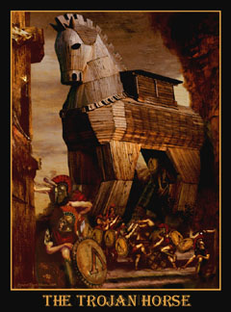

Slide 18
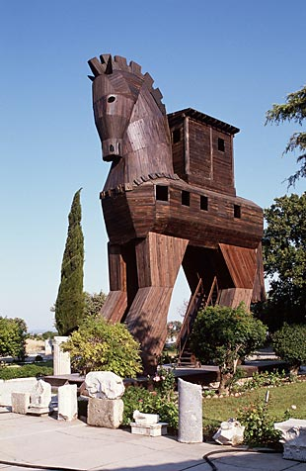

Slide 19
What happened. . .
The Mycenaeans killed the king of Troy and burned the city.
Then they returned to their homes with Helen.

Slide 20
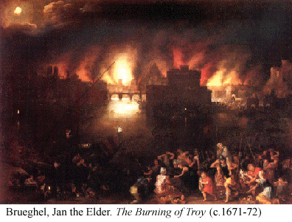

Slide 21
A Dark Age
The Mycenaeans never returned to a peaceful existence. The Dorians drove them out of Greece.

Slide 22
The Dark Age
The Mycenaeans settled in the Aegean islands and on the western shore of Asia Minor. Later, this was known as Ionia.

Slide 23
One step back. . .
This began a time of wandering and killing. Trade stopped. Many skills were forgotten including how to read and write, fresco painting, working with ivory and gold, etc.

Slide 24
Here we go again. . .
The people had to create a new civilization on their own beginning with herding and farming.

Slide 25
A New Name:
Eventually they developed independent communities and began calling themselves Hellenes, or Greeks.

Slide 26
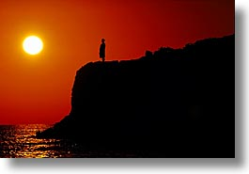
The rest is history.

Slide 27
This powerpoint was kindly donated to www.worldofteaching.com
http://www.worldofteaching.com is home to over a thousand powerpoints submitted by teachers. This is a completely free site and requires no registration. Please visit and I hope it will help in your teaching.

